Slide 1
Module 11: Defining Workflows to Orchestrate Functions
AWS Academy Cloud Developing
Notes:
Welcome to Module 11: Defining Workflows to Orchestrate Functions.

Slide 2
Section 1: Introduction
Module 11: Defining Workflows to Orchestrate Functions
Notes:
Section 1: Introduction.

Slide 3
Module objectives
At the end of this module, you should be able to do the following:
Recognize the dynamics of workflow coordination in distributed applications
Describe AWS Step Functions
Identify state types
Indicate common use cases for Step Functions
Recall Step Functions API operations
Notes:
At the end of this module, you should be able to do the following:
Recognize the dynamics of workflow coordination in distributed applications
Describe AWS Step Functions
Identify state types
Indicate common use cases for Step Functions
Recall Step Functions API operations

Slide 4
Module overview
Sections
Introduction
Coordinating tasks in distributed applications
Introducing Step Functions
State types
Step Functions use cases
Step Functions API
Demonstration
Creating Simple Calculators by Using Step Functions
Lab
Lab: Orchestrating Serverless Functions with Step Function
Notes:
This module includes the following sections:
Introduction
Coordinating tasks in distributed applications
Introducing Step Functions
State types
Step Functions use cases
Step Functions API
This module also includes:
A demonstration about creating simple calculators by using Step Functions
A lab where you will orchestrate serverless functions with Step Functions
Finally, you will complete a knowledge check to test your understanding of key concepts covered in this module.

Slide 5

Café business requirement
Now that the coffee inventory is automatically updated on the café website, Frank would like to be able to request reports with the latest inventory information. Sofía thinks she can use Step Functions to coordinate the steps to generate a report.
Notes:
Now that the coffee inventory is automatically updated on the café website, Frank would like to be able to request reports with the latest inventory information. Sofía thinks she can use Step Functions to coordinate the steps to generate a report.
The inventory information is stored in an Amazon Relational Database Service (Amazon RDS) database, and Sofía can create an AWS Lambda function to format the data into a report. She would like to be able to use the Amazon Simple Notification Service (Amazon SNS) to send Frank an email when the report is ready. Step Functions can orchestrate those tasks into a workflow.

Slide 6
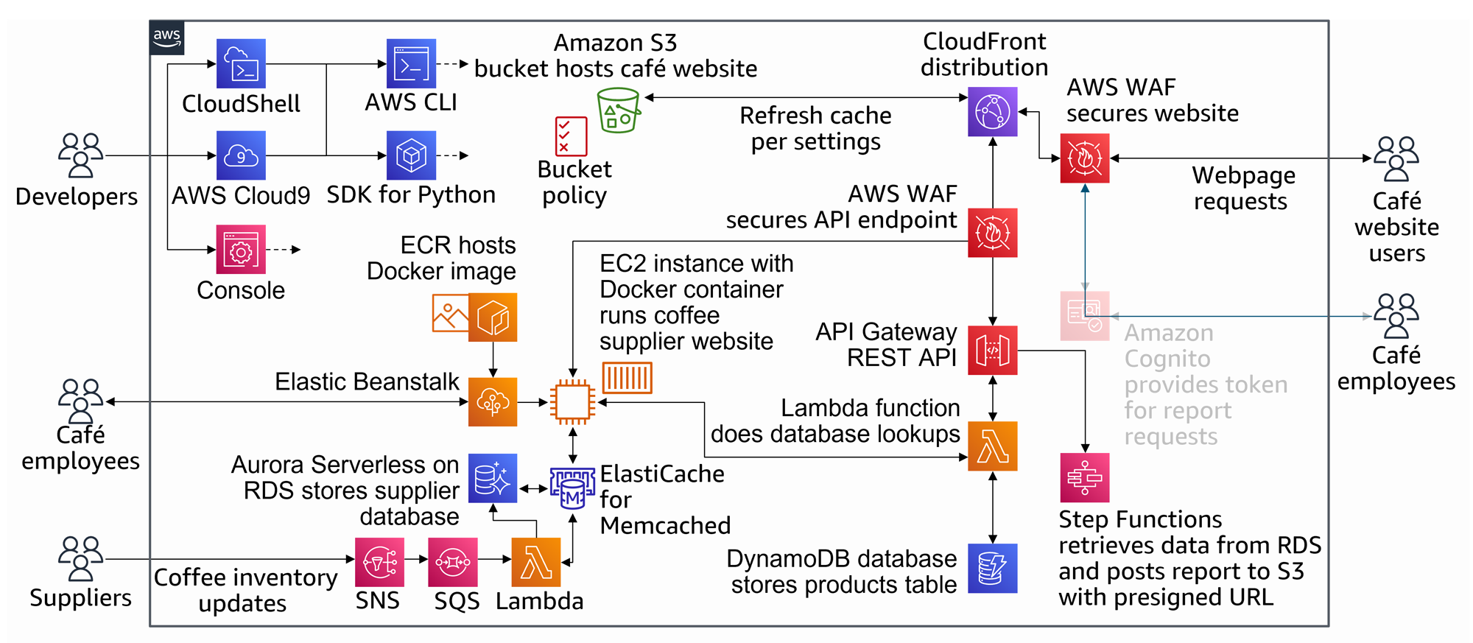
Step Functions as part of developing a cloud application
Notes:
The diagram on this slide gives an overview of the application that you will build through the labs in this course. The highlighted portions are relevant to this module. As highlighted in the diagram, you will create a Step Functions workflow and integrate it with a REST API. The workflow will coordinate the tasks of getting data from the database, generating a report, posting it to Amazon Simple Storage Service (Amazon S3), and sending a notification through Amazon SNS.

Slide 7
Section 2: Coordinating tasks in distributed applications
Module 11: Defining Workflows to Orchestrate Functions
Notes:
Section 2: Coordinating tasks in distributed applications.

Slide 8
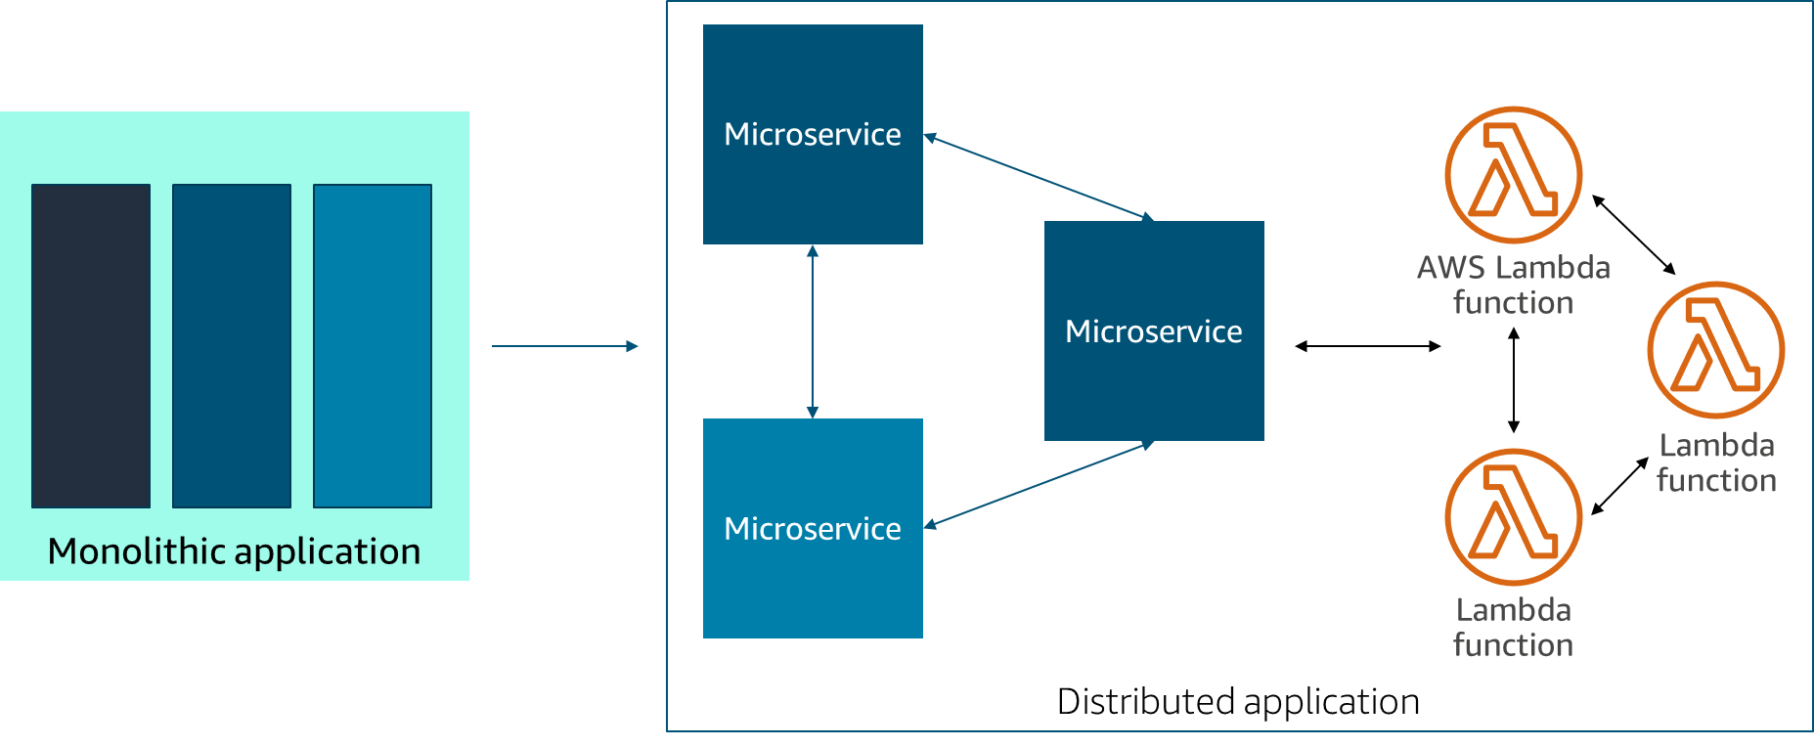
Microservices architecture for distributed applications
Notes:
In modern cloud architecture, applications are decoupled into smaller, independent components that are called microservices, which are easier to develop, deploy, and maintain. With microservices, you can build distributed applications from individual components that each perform a discrete function or task. You can use a microservices architecture to deploy, scale, and update components of your application quickly.

Slide 9
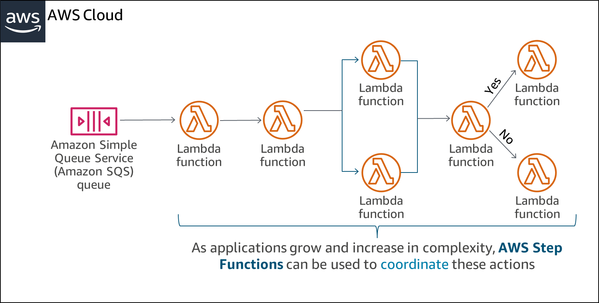
Challenges with distributed applications
Notes:
As your application grows in size, the number of components increases and you can have many patterns to run tasks. For example, consider a serverless application that is built by using AWS Lambda functions. You might want to invoke a Lambda function immediately after another function, and only if the first function runs successfully. You might want two functions to be invoked in parallel and then feed the combined results into a third function. Or you might want to choose which of two functions is invoked based on the output of another function.
Function invocation can result in an error for several reasons. Your code might raise an exception, time out, or run out of memory. The runtime that runs your code might encounter an error and stop. When an error occurs, your code might have run completely, partially, or not at all. In most cases, the client or service that invokes your function automatically retries if it encounters an error. Therefore, your code must be able to process the same event repeatedly without unwanted effects. If your function manages resources or writes to a database, you must handle cases where the same request is made several times.
You need a way to coordinate the components of your application. This coordination layer is necessary to provide the capability to scale automatically in response to changing workloads, and to handle errors and timeouts. It must also maintain the state of your application while it’s running. For example, it must track what step it’s in and store data that is moving between the steps of your workflow. These features will help you build and operate your applications. You also want visibility into your application so that you can troubleshoot errors and track performance.

Slide 10

Section 2 key takeaways
﻿Microservices are smaller, independent components that make up an application in modern cloud architecture.
You can use microservices to quickly deploy, scale, and update application components.
A coordination layer is necessary to handle automatic scaling, errors, and timeouts.
Notes:
The following are the key takeaways from this section of the module:
Microservices are smaller, independent components that make up an application in modern cloud architecture.
You can use microservices to quickly deploy, scale, and update application components.
A coordination layer is necessary to handle automatic scaling, errors, and timeouts.

Slide 11
Section 3: Introducing Step Functions
Module 11: Defining Workflows to Orchestrate Functions
Notes:
Section 3: Introducing Step Functions.

Slide 12

AWS Step Functions
Serverless orchestration service that you can use to combine Lambda functions and other AWS services to build critical applications
Coordinates components of distributed applications and microservices by using visual workflows
Automatically triggers and tracks each step, and retries when errors occur
Logs the state of each step
AWS Step Functions
Notes:
AWS Step Functions is a web service that you can use to coordinate components of distributed applications and microservices by using visual workflows. Step Functions provides a reliable way to coordinate components and step through the functions of your application. Step Functions offers a graphical console so that you can visualize the components of your application as a series of steps. It automatically triggers and tracks each step, and it also retries when errors occur, so your application runs in order and as expected. Step Functions logs the state of each step, so you can diagnose and debug problems quickly.
For more information about Step Functions, see https://aws.amazon.com/step-functions/.

Slide 13
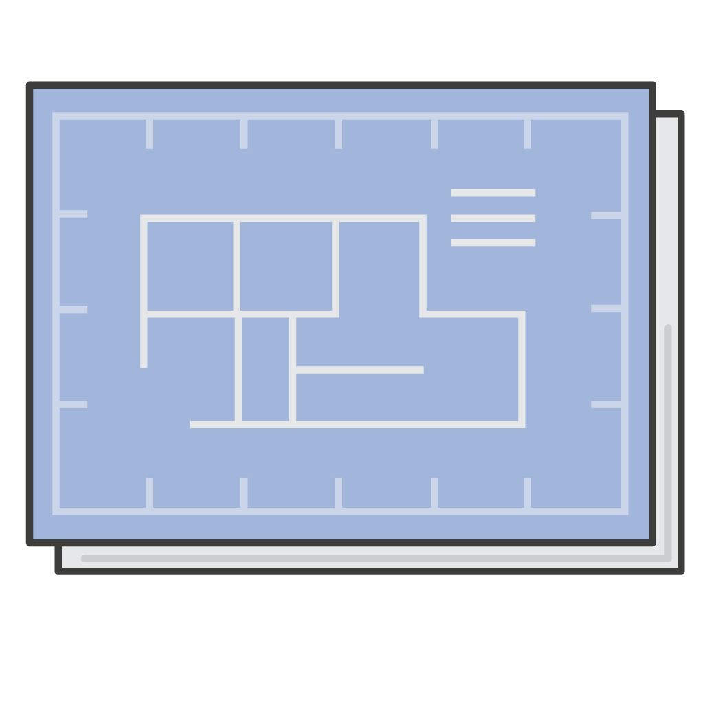
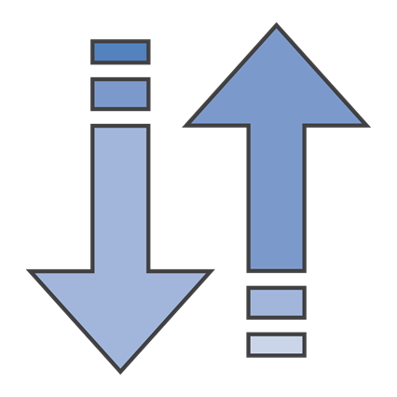
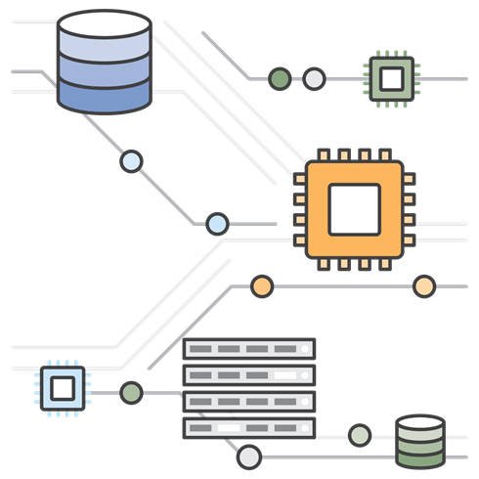
Benefits of Step Functions
Productivity
Build and update applications quickly
Agility
Scale and recover reliably
Resiliency
Evolve applications easily
Notes:
You can use Step Functions to do the following:
Build and update applications quickly: You can use Step Functions to build visual workflows that provide fast translation of business requirements into technical requirements. You can build applications in minutes. When needs change, you can exchange or reorganize components without customizing any code.
Scale and recover reliably: Step Functions automatically scales the operations and underlying compute to run the steps of your application for you in response to changing workloads. Step Functions scales automatically to help ensure that the performance of your application workflow remains consistent as the frequency of requests increases.
Evolve applications easily: Step Functions manages state, checkpoints, and restarts for you to make sure that your application runs in order and as expected. It has built-in try/catch, retry, and rollback capabilities to deal with errors and exceptions automatically.
For more information about Step Functions features, see https://aws.amazon.com/step-functions/features/.

Slide 14
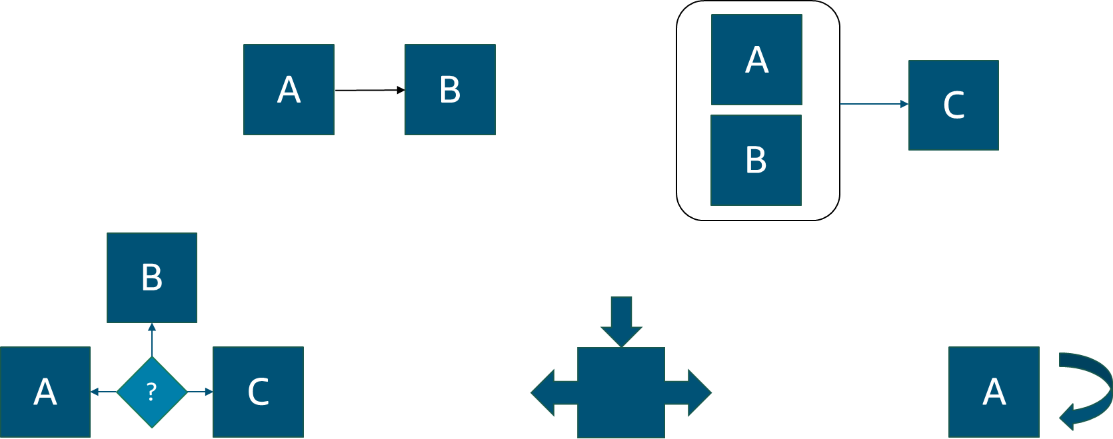
Workflow options
Run tasks in sequence
Run tasks in parallel
Select a task based on data
Manage try-catch-finally behavior
Retry failed tasks
Notes:
Step Functions manages the logic of your application for you and implements basic data types, such as running tasks sequentially and in parallel, branching, and timeouts. This process removes extra code that might be repeated in your microservices and functions. Step Functions automatically handles errors and exceptions with built-in try/catch and retry, whether the task takes seconds or months to complete. You can automatically retry failed or timed-out tasks, respond differently to different error types, and recover gracefully by returning to designated cleanup and recovery code.

Slide 15
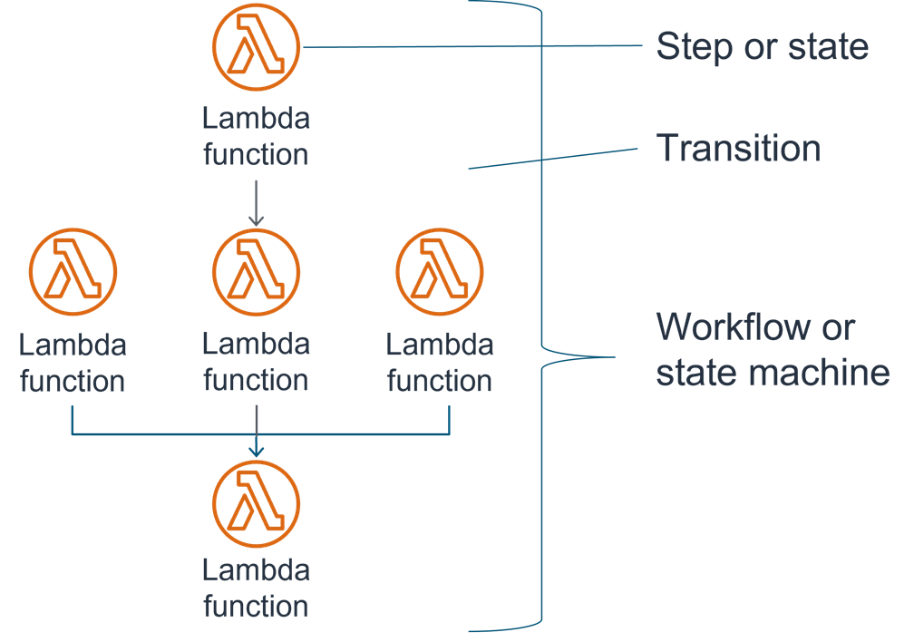
How Step Functions works
You define your workflow (or state machine) as a series of steps (or states) and transitions.
Tasks do all of the work in a state machine.
Each state machine starts with an input. The state transforms the input and passes the output to the next state.
You can visualize and track workflows in the Step Functions console.
Notes:
With Step Functions, you define a workflow as a series of steps and transitions between each step. A workflow is also called a state machine, and states are elements in a state machine. A state machine is an object that has a set number of operating conditions that depend on the object’s previous condition to determine output. As a result, individual states can make decisions based on their input, perform actions, and pass output to other states.
Tasks do all of the work in your state machine. As you will learn in the next section, a task can perform work by using an activity or an AWS Lambda function. Alternatively, it can pass parameters to the API actions of other services. Each state machine starts with an input. The state transforms the input and passes the output to the next state.
You can use the Step Functions console to visualize your state machine, and it provides near-real-time information on your state machine tasks.

Slide 16
Defining and visualizing workflows
Define the workflow in JSON by using the Amazon States Language
Visualize the workflow in the Step Functions console
{
"Comment": "A Hello World Example",
"StartAt": "HelloWorld",
"States": {
"HelloWorld": {
"Type": "Pass",
"Result": "Hello World!",
"End": true
}
}
}
Start
HelloWorld
End
Notes:
You define state machines by using the Amazon States Language (ASL). The Amazon States Language is a JSON-based, structured language. Step Functions then represents the JSON structure in a real-time graphical view so you can visualize your state machine directly in the Step Functions console.
AWS Step Functions Workflow Studio is another way to define state machines. You can use this low-code visual tool to build Step Functions through a guided, interactive interface, so that you can prototype and build workflows faster.
For more information about the Amazon States Language, see https://docs.aws.amazon.com/step-functions/latest/dg/concepts-amazon-states-language.html.
For more information about AWS Step Functions Workflow Studio, see https://docs.aws.amazon.com/step-functions/latest/dg/workflow-studio.html.

Slide 17
Running state machines
{
"Comment": "A Hello World Example",
"StartAt": "HelloWorld",
"States": {
"HelloWorld": {
"Type": "Pass",
"Result": "Hello World!",
"Next": "NextState"
}
"NextState": {
"Type": "Action",
"Resource": "arn:aws:lambda...",
"End": true
}
}
}
Running the state machine starts here (required)
State type (required)
The next state that is run when the current state finishes
State ends if set to true
Notes:
When a state machine is launched, the system begins with the state that is referenced in the top-level StartAt field. After Step Functions runs a state, it uses the value of the Next field to determine the next state to advance to. This step is called a transition.
A terminal state is a Succeed state, a Fail state, or if the End field is set to true. When the system reaches a terminal state or if a runtime error occurs, the state stops running and returns a result.
For more information, see the following sections of the AWS Step Functions Developer Guide:
Transitions: https://docs.aws.amazon.com/step-functions/latest/dg/concepts-transitions.html.
Common State Fields: https://docs.aws.amazon.com/step-functions/latest/dg/amazon-states-language-common-fields.html.

Slide 18
Section 3 key takeaways
﻿﻿Step Functions is a service that you can use to coordinate components of distributed applications and microservices by using visual workflows.
A state machine is an object that has a set number of operating conditions that depend on the object’s previous condition to determine the output.
State machines are defined by using the Amazon States Language.
Notes:
The following are the key takeaways from this section of the module:
Step Functions is a service that you can use to coordinate components of distributed applications and microservices by using visual workflows.
A state machine is an object that has a set number of operating conditions that depend on the object’s previous condition to determine output.
State machines are defined by using the Amazon States Language.

Slide 19
Section 4: State types
Module 11: Defining Workflows to Orchestrate Functions
Notes:
Section 4: State types.

Slide 20
State types
Task | A single unit of work
Choice | Adds branching logic to a state machine
Fail | Stops running a state and marks it as a failure
Succeed | Stops running a state successfully
Pass | Passes its input to its output, without performing work
Wait | Delays from continuing for a specified time
Parallel | Creates parallel branches for running states
Map | Dynamically iterates steps
Notes:
A finite state machine can express an algorithm as a number of states, their relationships, and their input and output. States are elements in your state machine. Individual states can make decisions based on their input, perform actions, and pass output to other states.
States can perform a variety of functions in your state machine:
Do some work in your state machine (a Task state)
Make a choice of which branch to run (a Choice state)
Stop running a state with a failure or success (a Fail state or Succeed state)
Pass its input to its output or inject some fixed data (a Pass state)
Provide a delay for a certain amount of time or until a specified time and date (a Wait state)
Begin running parallel branches (a Parallel state)
Dynamically iterate steps (a Map state)
In this section, you will learn about these different state types.
For more information about state types, see https://docs.aws.amazon.com/step-functions/latest/dg/concepts-states.html.

Slide 21



Task state
"ActivityState": {
"Type": "Task",
"Resource": "arn:aws:states:us-east-1:123456789012:activity:HelloWorld",
"TimeoutSeconds": 300,
"HeartbeatSeconds": 60,
"Next": "NextState"
}
Amazon Elastic Compute Cloud (Amazon EC2)
Amazon Elastic Container Service (Amazon ECS)
"LambdaState": {
"Type": "Task",
"Resource": "arn:aws:lambda:us-east-1:123456789012:function:HelloWorld",
"Next": "NextState"
}
Lambda function
Notes:
Tasks do all of the work in your state machine. A task performs work by using an activity or a Lambda function, or by passing parameters to the API actions of other services. The Amazon States Language represents tasks by setting a state’s type to Task (that is, "Type": "Task"). It also provides the task with the Amazon Resource Name (ARN) of the activity or Lambda function.
An activity consists of program code that waits for an operator to perform an action or to provide input. You can host activities on Amazon Elastic Compute Cloud (Amazon EC2), Amazon Elastic Container Service (Amazon ECS), or even mobile devices. Activities poll Step Functions by using the GetActivityTask, SendTaskSuccess, SendTaskFailure, and SendTaskHeartbeat API actions.
Step Functions can invoke Lambda functions directly from a task state. Step Functions also integrates with some AWS services, including the ability to directly call and pass parameters to the API of those services. You can use Step Functions to coordinate these services directly from the Amazon States Language.
The two examples show the Task state. The first example performs an activity that is named HelloWorld (which is identified by the activity ARN in the Resource field). The second example performs a Lambda function (which is identified by the Lambda function ARN).
For more information about the Task state, see https://docs.aws.amazon.com/step-functions/latest/dg/amazon-states-language-task-state.html.
For more information about how Step Functions integrates with other AWS services, see https://docs.aws.amazon.com/step-functions/latest/dg/concepts-connectors.html.

Slide 22
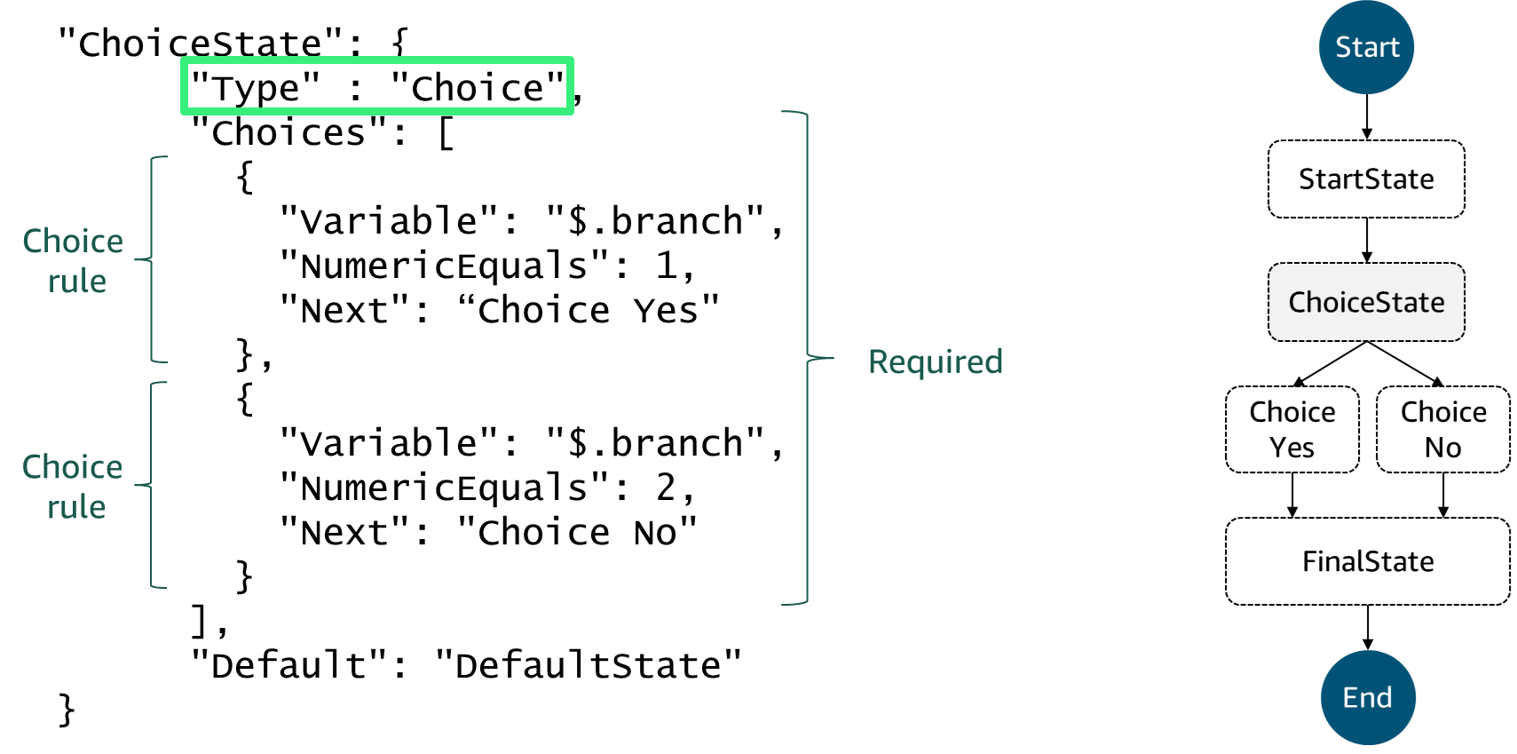
Choice state
Notes:
A Choice state ("Type": "Choice") adds branching logic to a state machine. A Choice state must have a Choices field whose value is a non-empty array, and whose element is an object called a Choice Rule.
A Choice Rule contains the following:
A comparison: Two fields that specify an input variable to be compared, the type of comparison, and the value to compare the variable to.
A Next field: The value of this field must match a state name in the state machine.
In the example, the first choice rule checks whether the numerical value is equal to 1. The second choice rule checks whether the numerical value is equal to 2.
Note: The "$" symbol in these examples is an indicator of a variable.
For more information about the Choice state, see https://docs.aws.amazon.com/step-functions/latest/dg/amazon-states-language-choice-state.html.

Slide 23
Fail and Succeed states
"FailState": {
"Type": "Fail",
"Cause": "Invalid response.",
"Error": "ErrorA"
}
Fail state
"SuccessState": {
"Type": "Succeed"
}
Succeed state
Notes:
A Fail state ("Type": "Fail") stops running the state machine and marks it as a failure. The Fail state requires the Type field (which specifies the state’s type). In addition, the Fail state offers the following optional fields:
Cause: Provides a custom failure string that can be used for operational or diagnostic purposes.
Error: Provides an error name that can be used for error handling (retry/catch), operational, or diagnostic purposes.
Because Fail states always exit the state machine, they have no Next field and they do not require an End field. The slide provides examples of a Succeed state and a Fail state.
A Succeed state ("Type": "Succeed") stops running a state successfully. The Succeed state is a useful target for Choice state branches that don't do anything except stop running the state. Because Succeed states are terminal states, they have no Next field, and they don't need an End field.
For more information, see the following sections of the AWS Step Functions Developer Guide:
Succeed: https://docs.aws.amazon.com/step-functions/latest/dg/amazon-states-language-succeed-state.html.
Fail: https://docs.aws.amazon.com/step-functions/latest/dg/amazon-states-language-fail-state.html.

Slide 24
Pass state
Start
"No-op": {
"Type": "Pass",
"Result": {
"x-datum": 0.381018,
"y-datum": 622.2269926397355
},
"ResultPath": "$.coords",
"Next": "End"
}
No-op
End
Notes:
A Pass state ("Type": "Pass") passes its input to its output, without performing work. Pass states are useful when constructing and debugging state machines.
This example shows a state machine that consists of a single Pass state. When this state machine runs, it injects some fixed data, which might be useful for testing purposes.
For more information about the Pass state, see https://docs.aws.amazon.com/step-functions/latest/dg/amazon-states-language-pass-state.html.

Slide 25

Wait state
Start
"wait_ten_seconds": {
"Type": "Wait",
"Seconds": 10,
"Next": "NextState"
}
StartState
WaitState
FinalState or NextState
End
Notes:
A Wait state ("Type": "Wait") delays the state machine from continuing for a specified time. You can choose either a relative time (specified in seconds from when the state begins), or an absolute end time (specified as a timestamp).
In this example, the Wait state introduces a 10-second delay into the state machine.
For more information about the Wait state, see https://docs.aws.amazon.com/step-functions/latest/dg/amazon-states-language-wait-state.html.

Slide 26
Parallel state
"LookupCustomerInfo": {
"Type": "Parallel",
"Branches": [
{
"StartAt": "PState1",
"States": {
"PState1": {…}
}
},
{
"StartAt": "PState2",
"States": {
"PState2": {…}
}
}
],
"Next": "NextState"
}
Start
StartState
Required
PState1
PState2
FinalState
End
Notes:
The Parallel state ("Type": "Parallel") creates parallel branches running within your state machine.
A Parallel state causes Step Functions to run each branch—starting with the state named in that branch's StartAt field—as concurrently as possible. It will wait until all branches reach a terminal state before it processes the Parallel state's Next field.
A branch can fail because of an unhandled error, or by transitioning to a Fail state. If a branch fails for either reason, the entire Parallel state is considered to have failed and all of its branches are stopped.
For more information about the Parallel state, see https://docs.aws.amazon.com/step-functions/latest/dg/amazon-states-language-parallel-state.html.

Slide 27
Map state
"Validate-All": {
"Type": "Map",
"InputPath": "$.detail",
"ItemsPath": "$.shipped",
"MaxConcurrency": 0,
"Iterator": {
"StartAt": "Validate",
"States": {
"Validate": {
"Type": "Task",
"Resource": "arn:aws:lambda:us-east-1:123456789012:function:ship-val",
"End" : true
}
}
},
"ResultPath": "$.detail.shipped",
"End": true
}
Iterator (required)
Notes:
The Map state ("Type": "Map") creates a set of steps that can be run for multiple entries of an array.
By using a Map state, Step Functions can run the same steps for multiple entries of an array in the state output. The Iterator field is required; this field’s value is a reference path that identifies where in the effective input the array field is found. In this slide’s example, the iterator is the "InputPath" field.
For more information about the Map state, see https://docs.aws.amazon.com/step-functions/latest/dg/amazon-states-language-map-state.html.

Slide 28
Section 4 key takeaways
Individual states can make decisions based on their input, perform actions, and pass and manipulate output to other states.
Add branching logic to a state machine by adding a Choice state.
Run multiple functions concurrently by using the Parallel state.
Succeed and Fail states do not require an End field.
Notes:
The following are the key takeaways from this section of the module:
Individual states can make decisions based on their input, perform actions, and pass and manipulate output to other states.
Add branching logic to a state machine by adding a Choice state.
Run multiple functions concurrently by using the Parallel state.
Succeed and Fail states do not require an End field.

Slide 29
Section 5: Step Functions use cases
Module 11: Defining Workflows to Orchestrate Functions
Notes:
Section 5: Step Functions use cases.

Slide 30
Standard and Express workflows
 | Standard | Express
Invocation Rate | 2,000 per second | 100,000 per second
Transition Rate | 4,000 per second | Nearly unlimited
Pricing | Per state transition | Per number and duration of requests for your workflow
Step Functions Activities | Supports Step Functions activities | Does not support Step Functions activities
Integrations and Patterns Support | Supports all service and integration patterns | Supports all service integrations and most patterns
Notes:
Step Functions has two types of workflow: Standard and Express. You define your state machine by using the Amazon States Language regardless of which workflow type you use. However, the state machine behavior when run will vary based on your choice of Standard or Express workflows.
For more information, see Standard vs. Express Workflows at https://docs.aws.amazon.com/step-functions/latest/dg/concepts-standard-vs-express.html.

Slide 31

Standard workflows
Ideal for long-running, auditable workflows
Can run for up to 1 year
Employ an exactly-once model
Never run more than once unless the Retry behavior is specified in ASL
Are billed according to the number of processed state transitions
AWS Step
Functions
Notes:
Standard workflows are ideal for long-running, auditable workflows, because they show a history of previous runs, and provide visual debugging. The full run history can be retrieved by using the Step Functions API for up to 90 days after your run has completed. Standard workflows have an exactly-once workflow model, which means that they never run more than once unless you have specified the Retry behavior in ASL. Therefore, they are suitable for non-idempotent actions because their invocations always result in a change of state.

Slide 32

Express workflows
Ideal for high-volume, event-processing workloads
Can run for up to 5 minutes
Employ an at-least-once (asynchronous) or at-most-once (synchronous) model
An invocation can run more than once
Are billed according to number and duration of requests, and memory that is consumed
AWS Express
Workflows
Notes:
Express workflows are ideal for high-event-rate workloads, such as streaming data processing and Internet of Things (IoT) data ingestion. Asynchronous Express workflows have an at-least-once workflow model, and Synchronous Express Workflows use an at-most-once workflow model. Express workflows can run for up to 5 minutes. They are billed based on the number of and duration of requests and memory that is consumed.

Slide 33
Step Functions use cases
Process data
Automate tasks
Modernize a monolithic application
Orchestrate an application
Transcode media files
Sequence batch processing jobs
Send messages from automated workflows
Publish events from serverless workflows
Coordinate container tasks in microservices and serverless applications
Access databases from serverless workflows
Sequence steps of machine learning (ML) workflows
Coordinate extract, transform, and load (ETL) jobs
AWS Step
Functions
Notes:
Step Functions can be used for a variety of use cases:
Process data
Automate tasks
Modernize a monolithic application
Orchestrate an application
Transcode media files
Sequence batch processing jobs
Send messages from automated workflows
Publish events from serverless workflows
Coordinate container tasks in microservices and serverless applications
Access databases from serverless workflows
Sequence steps of machine learning (ML) workflows
Coordinate extract, transform, and load (ETL) jobs
These use cases can rely on Standard or Express workflows depending on their requirements.
For information about specific use cases, see https://aws.amazon.com/step-functions/use-cases/.

Slide 34
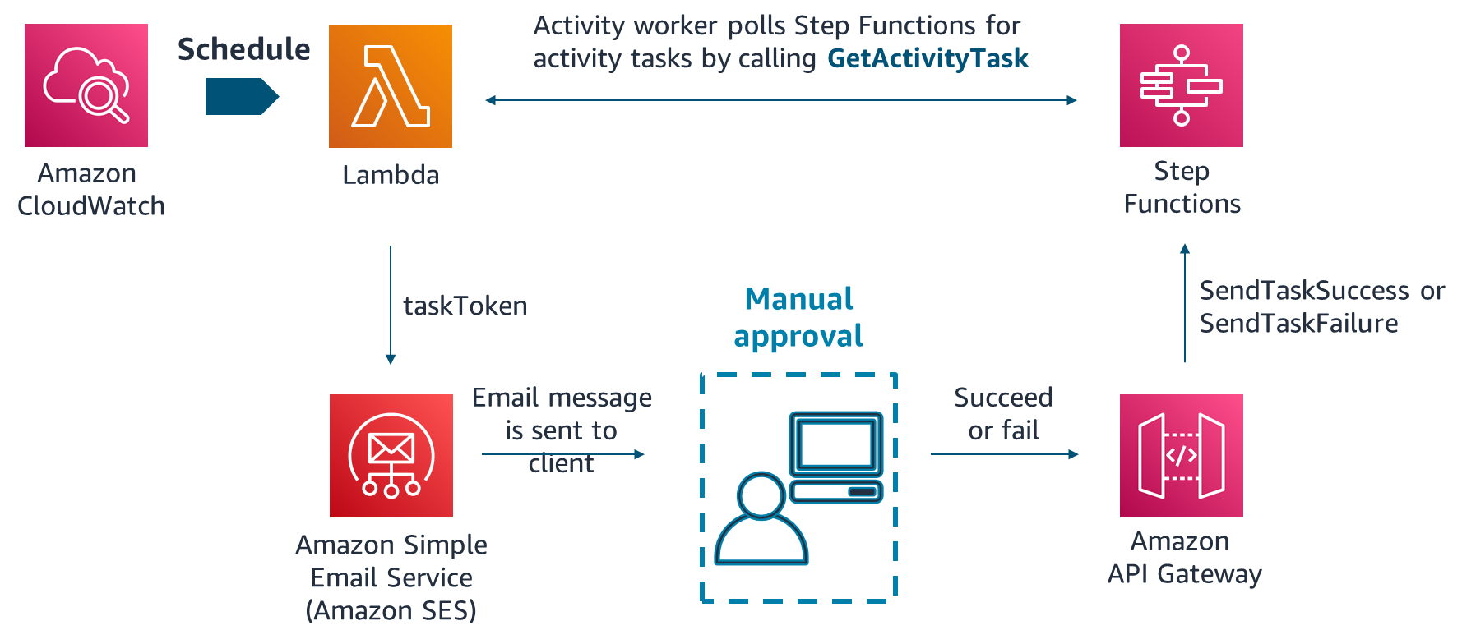
Step Functions use case example: Manual approval
Notes:
In Step Functions, activities are a way to associate code that runs somewhere (an activity worker) with a specific task in a state machine. An activity worker can be an application that runs on an EC2 instance, Lambda function, or mobile device. It can be any application that can make an HTTP connection, which is hosted anywhere.
When Step Functions reaches an activity task state, the workflow waits for an activity worker to poll for a task. An activity worker polls Step Functions by using the GetActivityTask API action, and it sends the ARN for the related activity. GetActivityTask returns a response, including input (a string of JSON input for the task) and a taskToken (a unique identifier for the task). A task that is waiting for a taskToken will wait until the invocation reaches the one-year service quota. It relies on a Heartbeat threshold, which is specified in the state machine's ASL definition.
A taskToken is a token that represents a specific task and is generated by Step Functions when tasks are assigned to a worker. After the activity worker completes its work, it can provide a report of its success or failure by using SendTaskSuccess or SendTaskFailure. These two calls use the taskToken that GetActivityTask provides to associate the result with that task.
One common use case for activities is to manage a workflow that has a manual approval step, such as a promotion approval. In this example, Amazon CloudWatch invokes Lambda on a schedule. Lambda (the activity worker) polls Step Functions for an activity task by calling GetActivityTask. First, Lambda successfully calls the API action. Next, the activity is vended to Lambda as a string of JSON input for the task and a taskToken for callback. Then, Lambda calls the Amazon Simple Email Service (Amazon SES) messaging service. The messaging service sends an email notification to a manager to either approve or deny an employee’s promotion. The response is recorded as either a success (approve) or failure (deny) and is sent as an API request to Amazon API Gateway. API Gateway calls either SendTaskSuccess or SendTaskFailure and uses the vended token.
This example shows a serverless application. The code that fetches the work and acquires the token is separate from the code that responds with the completion status and returns the token.
For more information, see the Implementing Serverless Manual Approval Steps in AWS Step Functions and Amazon API Gateway blog post at https://aws.amazon.com/blogs/compute/implementing-serverless-manual-approval-steps-in-aws-step-functions-and-amazon-api-gateway/.
For more information about activities, see https://docs.aws.amazon.com/step-functions/latest/dg/concepts-activities.html.

Slide 35
Use case example (continued)
{
"Comment": "Employee promotion process",
"StartAt": "ManualApproval",
"States": {
"ManualApproval": {
"Type": "Task",
"Resource": "arn:aws:states:us-east-1:ACCOUNT_ID:activity:ManualStep", "TimeoutSeconds": 3600,
"End": true
}
}
}
Notes:
The JSON for the activity state machine for the manual approval process might look like this code. In this example, the state type is "Task" and the activity ARN is provided as a resource for the task.
For more information about how to integrate Step Functions with other AWS services, see https://aws.amazon.com/step-functions/use-cases/.

Slide 36
Step Functions use case example: Machine learning workflow
Start
Build training
Train model
Build inference
Wait
Wait
Send success notification
Create endpoint config
Create endpoint config
Create model
Wait
Wait
Notes:
This diagram depicts the flow of a Step Functions state machine that is used for automated and continuous deployment of Amazon SageMaker models with Step Functions. The dashed arrows that are highlighted in pink are instances where the state machine must poll and wait for a task to be completed.
For more information, see the Automated and Continuous Deployment of Amazon SageMaker Models with AWS Step Functions blog post at https://aws.amazon.com/blogs/machine-learning/automated-and-continuous-deployment-of-amazon-sagemaker-models-with-aws-step-functions/.

Slide 37
Section 5 key takeaways
Activities are a Step Functions feature that associate code with a specific task in a state machine.
A taskToken is a token that represents a specific task that Step Functions generates when a task is assigned to a worker.
An activity worker can run on any application that is able to make an HTTP connection.
Notes:
The following are the key takeaways from this section of the module:
Activities are a Step Functions feature that associate code with a specific task in a state machine.
A taskToken is a token that represents a specific task that Step Functions generates when a task is assigned to a worker.
An activity worker can run on any application that is able to make an HTTP connection.

Slide 38
Section 6: Step Functions API
Module 11: Defining Workflows to Orchestrate Functions
Notes:
Section 6: Step Functions API.

Slide 39
Step Functions API
Create | Upload state machines that are defined in JSON. Register activity workers.
StartExecution | Return an Amazon Resource Name (ARN) that identifies the run.
StopExecution | Return the date that the state machine stopped.
List | List all state machines, runs, and activities.
Describe | Describe individual state machines, runs, and activities.
GetExecutionHistory | Get the history of a state machine run as a list of events.
Notes:
You can access and use Step Functions by using the AWS Management Console, AWS SDKs, or API.
You can run a Step Functions state machine by doing the following:
Call the Step Functions StartExecution API action.
Associate your Step Functions APIs with API operations in API Gateway. When an HTTPS request is sent to an API operation, API Gateway invokes your Step Functions API actions.
For more information, see the following resources:
AWS Step Functions API Reference: https://docs.aws.amazon.com/step-functions/latest/apireference/Welcome.html.
StartExecution: https://docs.aws.amazon.com/step-functions/latest/apireference/API_StartExecution.html.
Creating a Step Functions API Using API Gateway: https://docs.aws.amazon.com/step-functions/latest/dg/tutorial-api-gateway.html.
Periodically Start a State Machine Execution Using CloudWatch Events: https://docs.aws.amazon.com/step-functions/latest/dg/tutorial-cloudwatch-events-target.html.

Slide 40
Step Functions quotas
General quotas (for example, names in Step Functions)
Quotas that are related to:
Accounts (for example, maximum number of registered state machines or API actions)
State machine runs (for example, maximum runtime)
Task runs (for example, maximum task runtime)
API action throttling
State throttling
Quotas might differ between Standard and Express workflows
Notes:
Step Functions places quotas, formerly referred to as limits, on the sizes of certain state machine parameters. These parameters might include the number of API actions you can make during a certain time period or how many state machines you can define. Although these quotas are designed to prevent a misconfigured state machine from consuming all of the resources of the system, they aren't hard quotas. Quotas might differ significantly based on whether your state machine uses Standard or Express workflows.
For more information about these quotas, see https://docs.aws.amazon.com/step-functions/latest/dg/limits-overview.html.

Slide 41
Section 6 key takeaways
You can access Step Functions by using the AWS Management Console, AWS SDKs, or API.
Step Functions places quotas on the size of certain state machine parameters.
Use API Gateway to associate your Step Functions APIs with methods in an API Gateway API.
Notes:
The following are the key takeaways from this section of the module:
You can access Step Functions by using the console, AWS SDKs, or API.
Step Functions places quotas on the size of certain state machine parameters.
Use API Gateway to associate your Step Functions APIs with methods in an API Gateway API.

Slide 42
Demonstration: Creating Simple Calculators by Using Step Functions
Notes:
There is a video demonstration available for this topic. You can find this video within the module 11 section of the course with the title: Demo Creating Simple Calculators by Using Step Functions. If you are unable to locate this video demonstration please reach out to your educator for assistance.

Slide 43

Lab 11.1: Orchestrating Serverless Functions with Step Functions
Notes:
You will now complete Lab 11.1: Orchestrating Serverless Functions with Step Functions.

Slide 44
Lab: Scenario
In this lab, you will build the functionality to create and deliver the coffee inventory report using Step Functions.
Notes:
In this lab, you will build functionality to create and deliver the coffee inventory report using Step Functions.

Slide 45
Lab: Tasks
Preparing the development environment
Configuring an SNS topic and subscribing to it
Creating a Step Functions state machine
Creating a Lambda function to generate a presigned URL
Configuring the REST API to invoke the state machine
Configuring a Lambda function to generate an HTML report
Adding the GenerateHTML function to the state machine
Creating a Lambda function to retrieve supplier records
Adding the generateReportData function to the state machine
Notes:
In this lab, you will complete the following tasks:
Preparing the development environment
Configuring an SNS topic and subscribing to it
Creating a Step Functions state machine
Creating a Lambda function to generate a presigned URL
Configuring the REST API to invoke the state machine
Configuring a Lambda function to generate an HTML report
Adding the GenerateHTML function to the state machine
Creating a Lambda function to retrieve supplier records
Adding the generateReportData function to the state machine

Slide 46
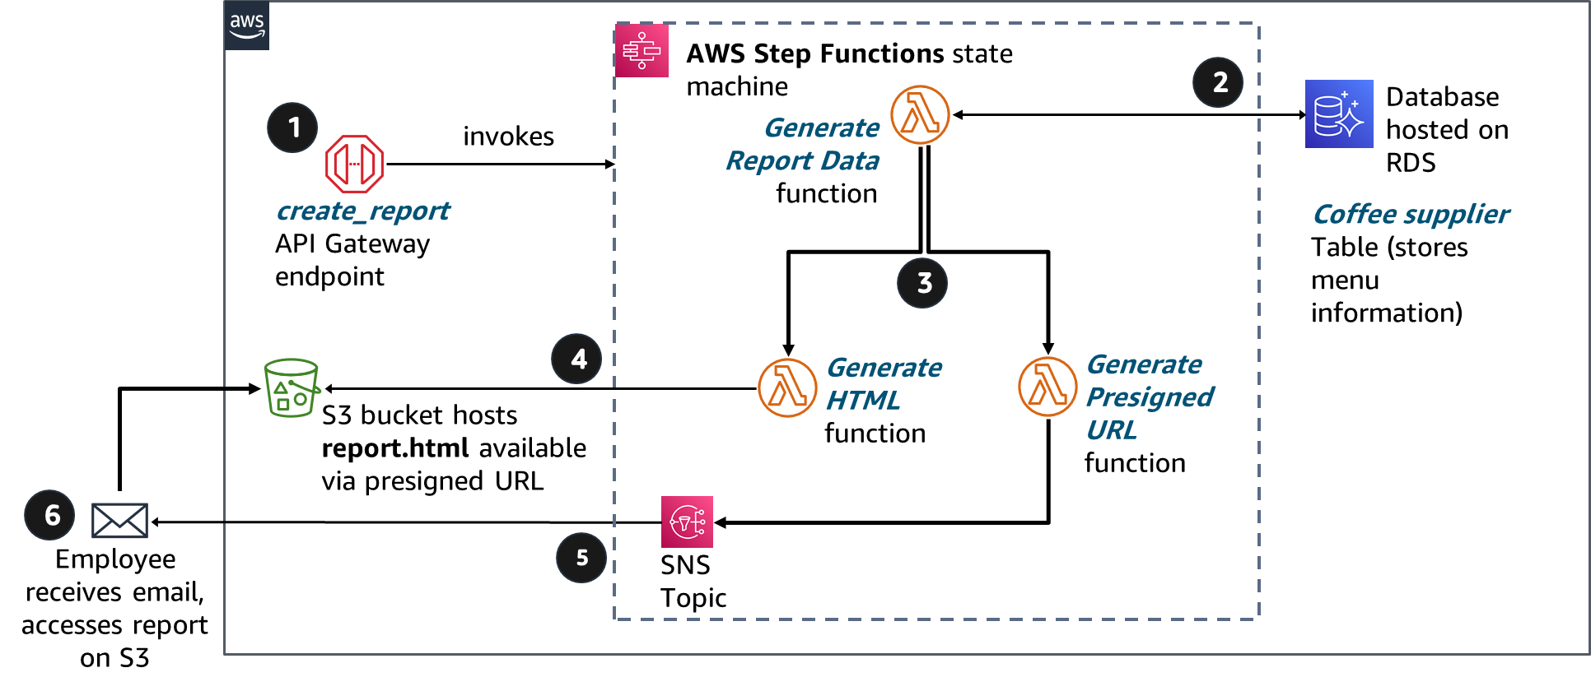
Lab: Final product
Notes:
The diagram summarizes what you will have built after you complete the lab.

Slide 47


Begin Lab 11.1: Orchestrating Serverless Functions with Step Functions
~ 90 minutes
Notes:
It is now time to start the lab.

Slide 48
Lab debrief: Key takeaways
Notes:
Your educator might choose to lead a conversation about the key takeaways from this lab after you have completed it.

Slide 49
Module wrap-up
Module 11: Defining Workflows to Orchestrate Functions
Notes:
It’s now time to review the module and wrap up with a knowledge check and discussion of a practice certification exam question.

Slide 50
Module summary
In summary, in this module, you learned how to:
Recognize the dynamics of workflow coordination in distributed applications
Describe Step Functions
Identify state types
Indicate common use cases for Step Functions
Recall Step Functions API operations
Notes:
In summary, in this module, you learned how to:
Recognize the dynamics of workflow coordination in distributed applications
Describe Step Functions
Identify state types
Indicate common use cases for Step Functions
Recall Step Functions API operations

Slide 51

Complete the knowledge check
Notes:
It is now time to complete the knowledge check for this module.

Slide 52
Sample exam question
When a customer submits a request for a credit limit increase, the request is to be processed automatically by comparing their request to their credit limit. If the request is more than their preapproved credit limit, Step Functions must send the request to a manager for approval.
Which type of state should be used to accomplish this process?
Identify the key words and phrases before continuing.
The following are the key words and phrases:
Comparing
Send the request to a manager
Notes:
It is important to fully understand the scenario and question being asked before even reading the answer choices. Find the keywords in this scenario and question that will help you find the correct answer.

Slide 53
Sample exam question: Responses
When a customer submits a request for a credit limit increase, the request is to be processed automatically by comparing their request to their credit limit. If the request is more than their preapproved credit limit, Step Functions must send the request to a manager for approval.
Which type of state should be used to accomplish this process?
Choice
Response
A
Parallel
B
Choice
C
Task
D
Pass
Notes:
Now that we have bolded the keywords in this scenario, let us look at the answers.

Slide 54
Sample exam question: Answer
The correct answer is B.
Choice
Response
A
Parallel
B
Choice
C
Task
D
Pass
Notes:
Look at the answer choices and rule them out based on the keywords that were previously highlighted.
The correct answer is B. Choice.
Using a Choice state, you can have Step Functions make decisions based on the Choice state’s input.

Slide 55
Additional resources
AWS Machine Learning Blog: Automated and continuous deployment of Amazon SageMaker models with AWS Step Functions
AWS Compute Blog: Implementing Serverless Manual Approval Steps in AWS Step Functions and Amazon API Gateway
AWS Technical Guide: Create a Serverless Content Syndication Pipeline with AWS Step Functions
FAQ: AWS Step Functions FAQs
Notes:
To learn more about the topics covered in this module, you might find the following additional resources helpful:
AWS Machine Learning Blog: https://aws.amazon.com/blogs/machine-learning/automated-and-continuous-deployment-of-amazon-sagemaker-models-with-aws-step-functions/.
AWS Compute Blog: https://aws.amazon.com/blogs/compute/implementing-serverless-manual-approval-steps-in-aws-step-functions-and-amazon-api-gateway/.
AWS Technical Guide: https://d1.awsstatic.com/whitepapers/create-a-serverless-content-syndication-pipeline-with-aws-step-functions.pdf?did=wp_card&trk=wp_card.
FAQ: https://aws.amazon.com/premiumsupport/knowledge-center/?ref=docs_gateway#AWS_Step_Functions.

Slide 56
Thank you
Corrections, feedback, or other questions?
Contact us at https://support.aws.amazon.com/#/contacts/aws-academy.
Notes:
Thank you for completing this module.

Slide 57
Image source files for development use only.

Slide 58
























Step Functions as part of developing a cloud application
Amazon S3
bucket hosts café website
CloudFront distribution
AWS CLI
AWS WAF secures website
CloudShell
Refresh cache per settings
Bucket policy
Webpage requests
Developers
AWS Cloud9
SDK for Python
AWS WAF secures API endpoint
Café website users
ECR hosts Docker image
EC2 instance with Docker container runs coffee supplier website
Console
API Gateway REST API
Amazon Cognito provides token for report requests
Café employees
Elastic Beanstalk
Lambda function does database lookups
Café employees
Aurora Serverless on RDS stores supplier database
ElastiCache for Memcached
Step Functions retrieves data from RDS and posts report to S3 with presigned URL
DynamoDB database stores products table
Coffee inventory
updates
Suppliers
SNS
SQS
Lambda
Notes:
Source graphic for café application.

Slide 59
Microservices architecture for distributed applications
Microservice
Monolithic application
Microservice
AWS Lambda function
Microservice
Lambda function
Lambda function
Distributed application
Notes:
In modern cloud architecture, applications are decoupled into smaller, independent components that are called microservices, which are easier to develop, deploy, and maintain. With microservices, you can build distributed applications from individual components that each perform a discrete function or task. You can use a microservices architecture to deploy, scale, and update components of your application quickly.

Slide 60

Challenges with distributed applications
AWS Cloud
Lambda function
Yes
Lambda function
Amazon Simple Queue Service (Amazon SQS) queue
No
Lambda function
Lambda function
Lambda function
Lambda function
Lambda function
As applications grow and increase in complexity, AWS Step Functions can be used to coordinate these actions
Notes:
As your application grows in size, the number of components increases and you can have many patterns to run tasks. For example, consider a serverless application that is built by using AWS Lambda functions. You might want to invoke a Lambda function immediately after another function, and only if the first function runs successfully. You might want two functions to be invoked in parallel and then feed the combined results into a third function. Or you might want to choose which of two functions is invoked based on the output of another function.
Function invocation can result in an error for several reasons. Your code might raise an exception, time out, or run out of memory. The runtime that runs your code might encounter an error and stop. When an error occurs, your code might have run completely, partially, or not at all. In most cases, the client or service that invokes your function automatically retries if it encounters an error. Therefore, your code must be able to process the same event repeatedly without unwanted effects. If your function manages resources or writes to a database, you must handle cases where the same request is made several times.
You need a way to coordinate the components of your application. This coordination layer is necessary to provide the capability to scale automatically in response to changing workloads, and to handle errors and timeouts. It must also maintain the state of your application while it’s running. For example, it must track what step it’s in and store data that is moving between the steps of your workflow. These features will help you build and operate your applications. You also want visibility into your application so that you can troubleshoot errors and track performance.

Slide 61
Workflow options
A
A
B
C
B
Run tasks in sequence
B
Run tasks in parallel
A
?
C
A
Select a task based on data
Manage try-catch-finally behavior
Retry failed tasks
Notes:
Step Functions manages the logic of your application for you and implements basic data types, such as running tasks sequentially and in parallel, branching, and timeouts. This process removes extra code that might be repeated in your microservices and functions. Step Functions automatically handles errors and exceptions with built-in try/catch and retry, whether the task takes seconds or months to complete. You can automatically retry failed or timed-out tasks, respond differently to different error types, and recover gracefully by returning to designated cleanup and recovery code.

Slide 62
How Step Functions works
You define your workflow (or state machine) as a series of steps (or states) and transitions.
Tasks do all of the work in a state machine.
Each state machine starts with an input. The state transforms the input and passes the output to the next state.
You can visualize and track workflows in the Step Functions console.
Step or state
Lambda
function
Transition
Workflow or state machine
Lambda
function
Lambda
function
Lambda
function
Lambda
function
Notes:
With Step Functions, you define a workflow as a series of steps and transitions between each step. A workflow is also called a state machine, and states are elements in a state machine. A state machine is an object that has a set number of operating conditions that depend on the object’s previous condition to determine output. As a result, individual states can make decisions based on their input, perform actions, and pass output to other states.
Tasks do all of the work in your state machine. As you will learn in the next section, a task can perform work by using an activity or an AWS Lambda function. Alternatively, it can pass parameters to the API actions of other services. Each state machine starts with an input. The state transforms the input and passes the output to the next state.
You can use the Step Functions console to visualize your state machine, and it provides near-real-time information on your state machine tasks.

Slide 63
Choice state
"ChoiceState": {
"Type" : "Choice",
"Choices": [
{
"Variable": "$.branch",
"NumericEquals": 1,
"Next": “Choice Yes"
},
{
"Variable": "$.branch",
"NumericEquals": 2,
"Next": "Choice No"
}
],
"Default": "DefaultState"
}
Start
StartState
Choice rule
ChoiceState
Required
Choice Yes
Choice No
Choice rule
FinalState
End
Notes:
A Choice state ("Type": "Choice") adds branching logic to a state machine. A Choice state must have a Choices field whose value is a non-empty array, and whose element is an object called a Choice Rule.
A Choice Rule contains the following:
A comparison: Two fields that specify an input variable to be compared, the type of comparison, and the value to compare the variable to.
A Next field: The value of this field must match a state name in the state machine.
In the example, the first choice rule checks whether the numerical value is equal to 1. The second choice rule checks whether the numerical value is equal to 2.
Note: The "$" symbol in these examples is an indicator of a variable.
For more information about the Choice state, see https://docs.aws.amazon.com/step-functions/latest/dg/amazon-states-language-choice-state.html.

Slide 64






Step Functions use case example: Manual approval
Activity worker polls Step Functions for activity tasks by calling GetActivityTask
Schedule
Amazon CloudWatch
Lambda
Step Functions
taskToken
Manual approval
SendTaskSuccess or SendTaskFailure
Email message is sent to client
Succeed or fail
Amazon Simple Email Service (Amazon SES)
Amazon API Gateway
Notes:
In Step Functions, activities are a way to associate code that runs somewhere (an activity worker) with a specific task in a state machine. An activity worker can be an application that runs on an EC2 instance, Lambda function, or mobile device. It can be any application that can make an HTTP connection, which is hosted anywhere.
When Step Functions reaches an activity task state, the workflow waits for an activity worker to poll for a task. An activity worker polls Step Functions by using the GetActivityTask API action, and it sends the ARN for the related activity. GetActivityTask returns a response, including input (a string of JSON input for the task) and a taskToken (a unique identifier for the task). A task that is waiting for a taskToken will wait until the invocation reaches the one-year service quota. It relies on a Heartbeat threshold, which is specified in the state machine's ASL definition.
A taskToken is a token that represents a specific task and is generated by Step Functions when tasks are assigned to a worker. After the activity worker completes its work, it can provide a report of its success or failure by using SendTaskSuccess or SendTaskFailure. These two calls use the taskToken that GetActivityTask provides to associate the result with that task.
One common use case for activities is to manage a workflow that has a manual approval step, such as a promotion approval. In this example, Amazon CloudWatch invokes Lambda on a schedule. Lambda (the activity worker) polls Step Functions for an activity task by calling GetActivityTask. First, Lambda successfully calls the API action. Next, the activity is vended to Lambda as a string of JSON input for the task and a taskToken for callback. Then, Lambda calls the Amazon Simple Email Service (Amazon SES) messaging service. The messaging service sends an email notification to a manager to either approve or deny an employee’s promotion. The response is recorded as either a success (approve) or failure (deny) and is sent as an API request to Amazon API Gateway. API Gateway calls either SendTaskSuccess or SendTaskFailure and uses the vended token.
This example shows a serverless application. The code that fetches the work and acquires the token is separate from the code that responds with the completion status and returns the token.
For more information, see the Implementing Serverless Manual Approval Steps in AWS Step Functions and Amazon API Gateway blog post at https://aws.amazon.com/blogs/compute/implementing-serverless-manual-approval-steps-in-aws-step-functions-and-amazon-api-gateway/.
For more information about activities, see https://docs.aws.amazon.com/step-functions/latest/dg/concepts-activities.html.

Slide 65



Lab: Final product (source graphic)
Lab: Final product
AWS Step Functions state machine
2
Database hosted on RDS
1
invokes
Generate
Report Data
function
create_report
API Gateway endpoint
Coffee supplier
Table (stores menu information)
3
4
Generate
HTML
function
Generate Presigned URL
function
S3 bucket hosts
report.html available
via presigned URL
6
Employee receives email, accesses report on S3
5
SNS Topic
Notes:
Source graphic for lab architecture.

